Slide 1
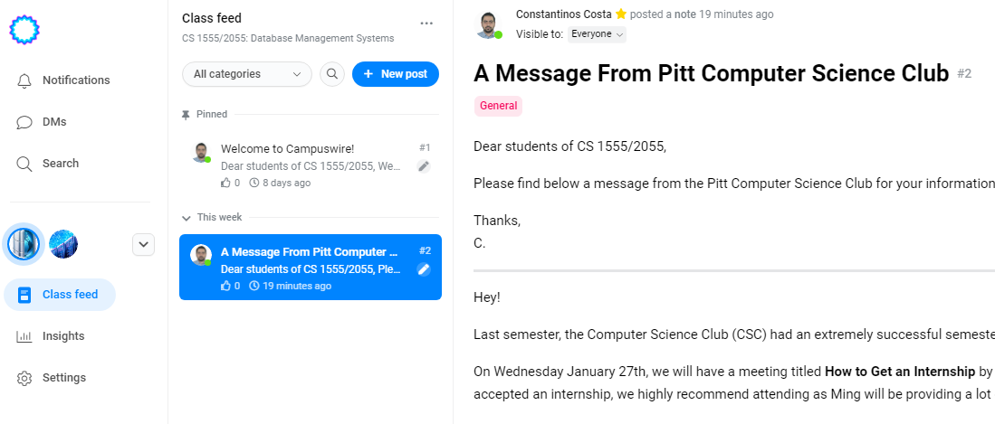
Announcements
Campuswire
30 / 53 joined
Midterm Exam
The Midterm Exam has been scheduled for Mar 15th

Slide 2
Overview of Database Management Systems Part II
Notes:
Definitions
Advantages
System Architectures

Slide 3
Database Vs. File Systems Approaches
Abstraction
Reliability
Efficiency/Performance

Slide 4
Data Abstraction
Data are structured in a way meaningful to applications
Data Model:
A collection of high-level data description constructs that hide low-level storage details
The Relational / Object-Relational Model:
Is the most widely used data model today
Main construct is a relation: table of records
Every relation has a schema:
Relation name
Names of fields
Types of fields

Slide 5
Example
Students
Attribute or Field
SID | Name | Age | GPA
546007 | Peter | 18 | 3.8
546100 | Bob | 19 | 3.65
546500 | Bill | 20 | 3.7
Schema
Record or Tuple
Schema:
Students (sid: string, name: string, age: integer, gpa: real)
State: Actual data at a given point in time
Notes:
Schema or Intension
State or Extension or Instance

Slide 6
Database Languages
Data Definition Language (DDL):
Define schemas
Define Integrity Constraints
Example: unique SIDs
More…
Data Manipulation Language (DML):
To ask questions = Query
Example: Which students have GPA > 3.75?
To create and modify data
SQL: Most widely used database language

Slide 7
Good DBMS ≠ Good Design!
Attribute or Field
SID | Name | Age | GPA
546007 | Peter | 18 | 3.8
546100 | Bob | 19 | 3.65
546500 | Bill | 20 | 3.7
Schema
Record or Tuple
Schema:
Students (sid: string, name: string, age: integer, gpa: real)
Alternative Schema:
Students (sid: integer, fname: string, lname: string, dob: date, gpa: real)

Slide 8
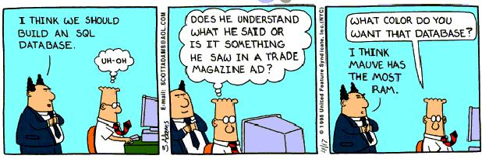
Now we know the color of the Database

Slide 9
Levels of Data Abstraction in a DBMS
The data in a DBMS is described at three levels of abstraction:
Conceptual Schema DDL: data definition language
Physical Schema SDL: storage definition language
External Schema (Views) VDL: view definition language
Many external schemas
plus one conceptual
plus one physical
External
Schema 1
External
Schema 2
External
Schema 3
Conceptual
Schema
Physical
Schema
Disk
Notes:
Data independence: logical and physical
Program-data independence
Consider adding a new field
Program-operation independence
User-defined abstract operation

Slide 10
External Schema - Views
Allows data access to be customized and authorized at the user-level
Defined in terms of data model
Consists of a collection of views
Example:
CourseEnroll (cid: string, enrollment: int)
Guided by end-user requirements
Views are computed as needed
Multiple Views of data allows each user/application to get different perspective of the database
CID | Enroll
CS 1555 | 37
CS 2550 | 17
CS 3551 | 15

Slide 11
3-level Architecture
view level
CSMajors
MathMajors
logical level: entire database schema
Courses (CourseNo,CourseName,Credits,Dept)
Students (StudentID,Lname,Name,Class,Major)
GradeReport (StudentID,CourseNo,Grade,Term)
physical level:
how these tables are stored
how many bytes and attribute, etc.

Slide 12
Execution Abstraction
A transaction is a logical unit of work in DBMSs
It is the execution of a program segment that performs some function or task by accessing shared data (e.g., a db)
logical grouping of query and update requests needed to perform a task
Examples:
deposit, withdraw, transfer money (banking transaction)
reserve a seat on a flight (airline reservation)
print monthly payment checks (business transaction)
update inventory (inventory transaction)

Slide 13
ACID Properties
Atomicity (alias failure atomicity)
Either all the operations associated with a transaction happen or none of them happens
Consistency Preservation
A transaction is a correct program segment. It satisfies the integrity constraints on the database at the transaction's boundaries
Isolation (alias concurrency atomicity / serializability)
Transactions are independent, the result of the execution of concurrent transactions is the same as if transactions were executed serially, one after the other
Durability (alias persistence / permanence)
The effects of completed transactions become permanent surviving any subsequent failures

Slide 14



Transfer Money Example
Two accounts:
A: $100
B: $200
Client 1: transfer $6 from A to B
Client 1
Read A: $100
Write A: $94
Read B: $200
Write B: $206

Slide 15
ACID Properties
Atomicity (alias failure atomicity)
Either all the operations associated with a transaction happen or none of them happens
Consistency Preservation
A transaction is a correct program segment. It satisfies the integrity constraints on the database at the transaction's boundaries
Isolation (alias concurrency atomicity / serializability)
Transactions are independent, the result of the execution of concurrent transactions is the same as if transactions were executed serially, one after the other
Durability (alias persistence / permanence)
The effects of completed transactions become permanent surviving any subsequent failures

Slide 16
Transfer Money Example [Poll]
Three accounts:
A: $100
B: $200
C: $300
Client 1: transfer $6 from A to B
Client 2: transfer $4 from C to B
Client 1 | Client 2
Read A: $100
Write A: $94
 | Read C: $300
 | Write C: $296
Read B: $200
 | Read B: $200
 | Write B: $204
Write B: $206

Slide 17
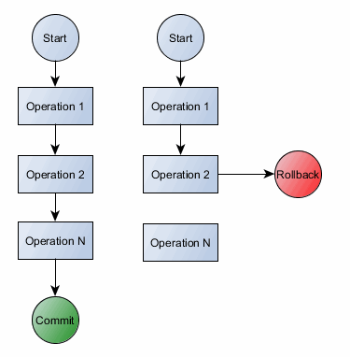
SQL TRANSACTIONS
Begin:
Each SQL statement should implicitly start a transaction, unless one is active.
COMMIT [ WORK ]; or END [ WORK ];
ROLLBACK [ WORK] ;
ROLLBACK default action
Notes:
Oracle allows naming of transactions: SET TRANSACTION READ Name “myTRX”;

Slide 18
Sample Transfer Money SQL code
-- Client 1
BEGIN;
UPDATE ACCOUNT
SET BALANCE = BALANCE - 6
WHERE NAME = 'A’;
UPDATE ACCOUNT
SET BALANCE = BALANCE + 6
WHERE NAME = 'B’;
COMMIT;
-- Client 2
BEGIN;
UPDATE ACCOUNT
SET BALANCE = BALANCE - 4
WHERE NAME = 'C’;
UPDATE ACCOUNT
SET BALANCE = BALANCE + 4
WHERE NAME = 'B’;
COMMIT;

Slide 19








ACID in NoSQL Databases
ACID to BaSE: No immediate consistency, data freshness & accuracy
Basic Availability: The database appears to work most of the time.
Soft-state: Stores don’t have to be write-consistent, nor do different replicas have to be mutually consistent all the time.
Eventual consistency: Stores exhibit consistency at some later point (e.g., lazily at read time).

Slide 20
Database Vs. File Systems Approaches
Abstraction
Data
Execution
Reliability
Efficiency/Performance

Slide 21
Reliability
Enforcing integrity constraints
E.g., data type, relationship between values
Data in DB must satisfy the integrity constraints
Transactions are committed if they do not violate any integrity constraint
Integrity constraints are stored in the catalog
Ensuring data integrity despite failures
Data are not lost when the system or a transaction fails for whatever reason
Notes:
Failed transactions are rolled back (Backup & Recovery)

Slide 22
Reliability…
Ensuring data integrity …
Security
Encryption & Private Information Retrieval
Authentication
Data Domains, Compartmentalization
Access control
Who (user/role), what (data), how (operations)
Views and access permissions in the catalog
Notes:
PIR: Private Information Retrieval

Slide 23
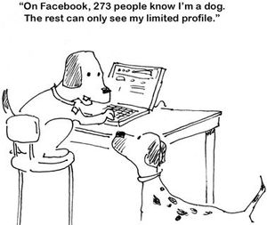
Example: Database Access ☺

Slide 24
Database Vs. File Systems Approaches
Abstraction
Data
Execution
Reliability
Efficiency/Performance

Slide 25
Performance Problems with Files
Report Program
Redundancy
- waste of space
Waste of effort
- Same change in multiple places
Need for coordination - inconsistent data - independent updates - E.g., Jan-19-1974 vs. Jan-29-1974
Data Description
Files
Students & grades
Accounting Program
Data Description
Files
Students & bills
CSD Program
Data Description
Files
Students, Courses & Faculty

Slide 26

No Performance Problems with DBs
Report Program
Files
Accounting Program
DB
Data Description
Students, grades
Files
Bills
Courses & Faculty
CSD Program

Slide 27
Database Management System (DBMS)
Web
Forms
Embedded
SQL
Interactive
SQL
Applications
SQL Commands
DBMS
Query
Evaluation Engine
Concurrency
Control
Files and Access Methods
Recovery
Manager
Buffer Manager
Disk Space Manager
Data Files
System Catalog
Index Files
Database
Notes:
Better figure/components

Slide 28
Efficiency and Performance
Space efficiency:
minimizes data redundancy by storing data only once
Time efficiency (response time):
eliminates the need for multiple updates to keep the replicas consistent and up-to-date
Enhances query performance by means of optimizations and access methods
Allows many users (transactions) to access and share the database concurrently
Notes:
Sequential access delays grow exponentially with # of transactions
Concurrency Control: not to step on each other’s toes

Slide 29
Performance Requirements
Abstraction
Data abstraction
Execution abstraction
Reliability
High availability: recovery time is short
Trusted/Quality data
Efficiency/Performance
High throughput
(Committed transactions per unit time)
Short or bounded response time
Energy Efficiency

Slide 30
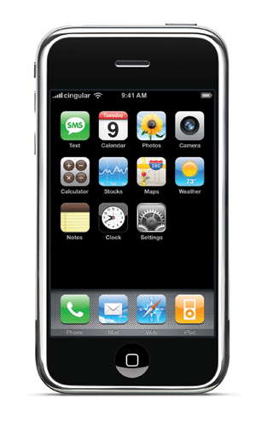
When an SQL-DBMS is Inappropriate?
Disadvantages:
Price to buy (DBMS & Hardware)
additional expertise (SQL/DBA)
Hence, it is over-kill when
the database has simple structure and/or its size is small
the application is simple, special purpose and is not expected to change
Concurrent, multiple-user access is not required
Can tolerate failures
Monitor applications, high volume of updates
Notes:
Say that NoSQL is the bridge between pure SQL and Files

Slide 31
When a DBMS is needed?
To integrate efficiently and correctly large volumes of related data
Central control, tuning for better performance, security
Building of large applications
New applications using a DBMS is estimated 1/6 to ¼ of the time of application using a file system
Economy of scale
Expandability/Flexibility
Supports evolution without affecting existing applications
Supports sharing and discovering of information
Data mining, deductive databases, active databases
DBMS ensure true QoS

